Slide 1
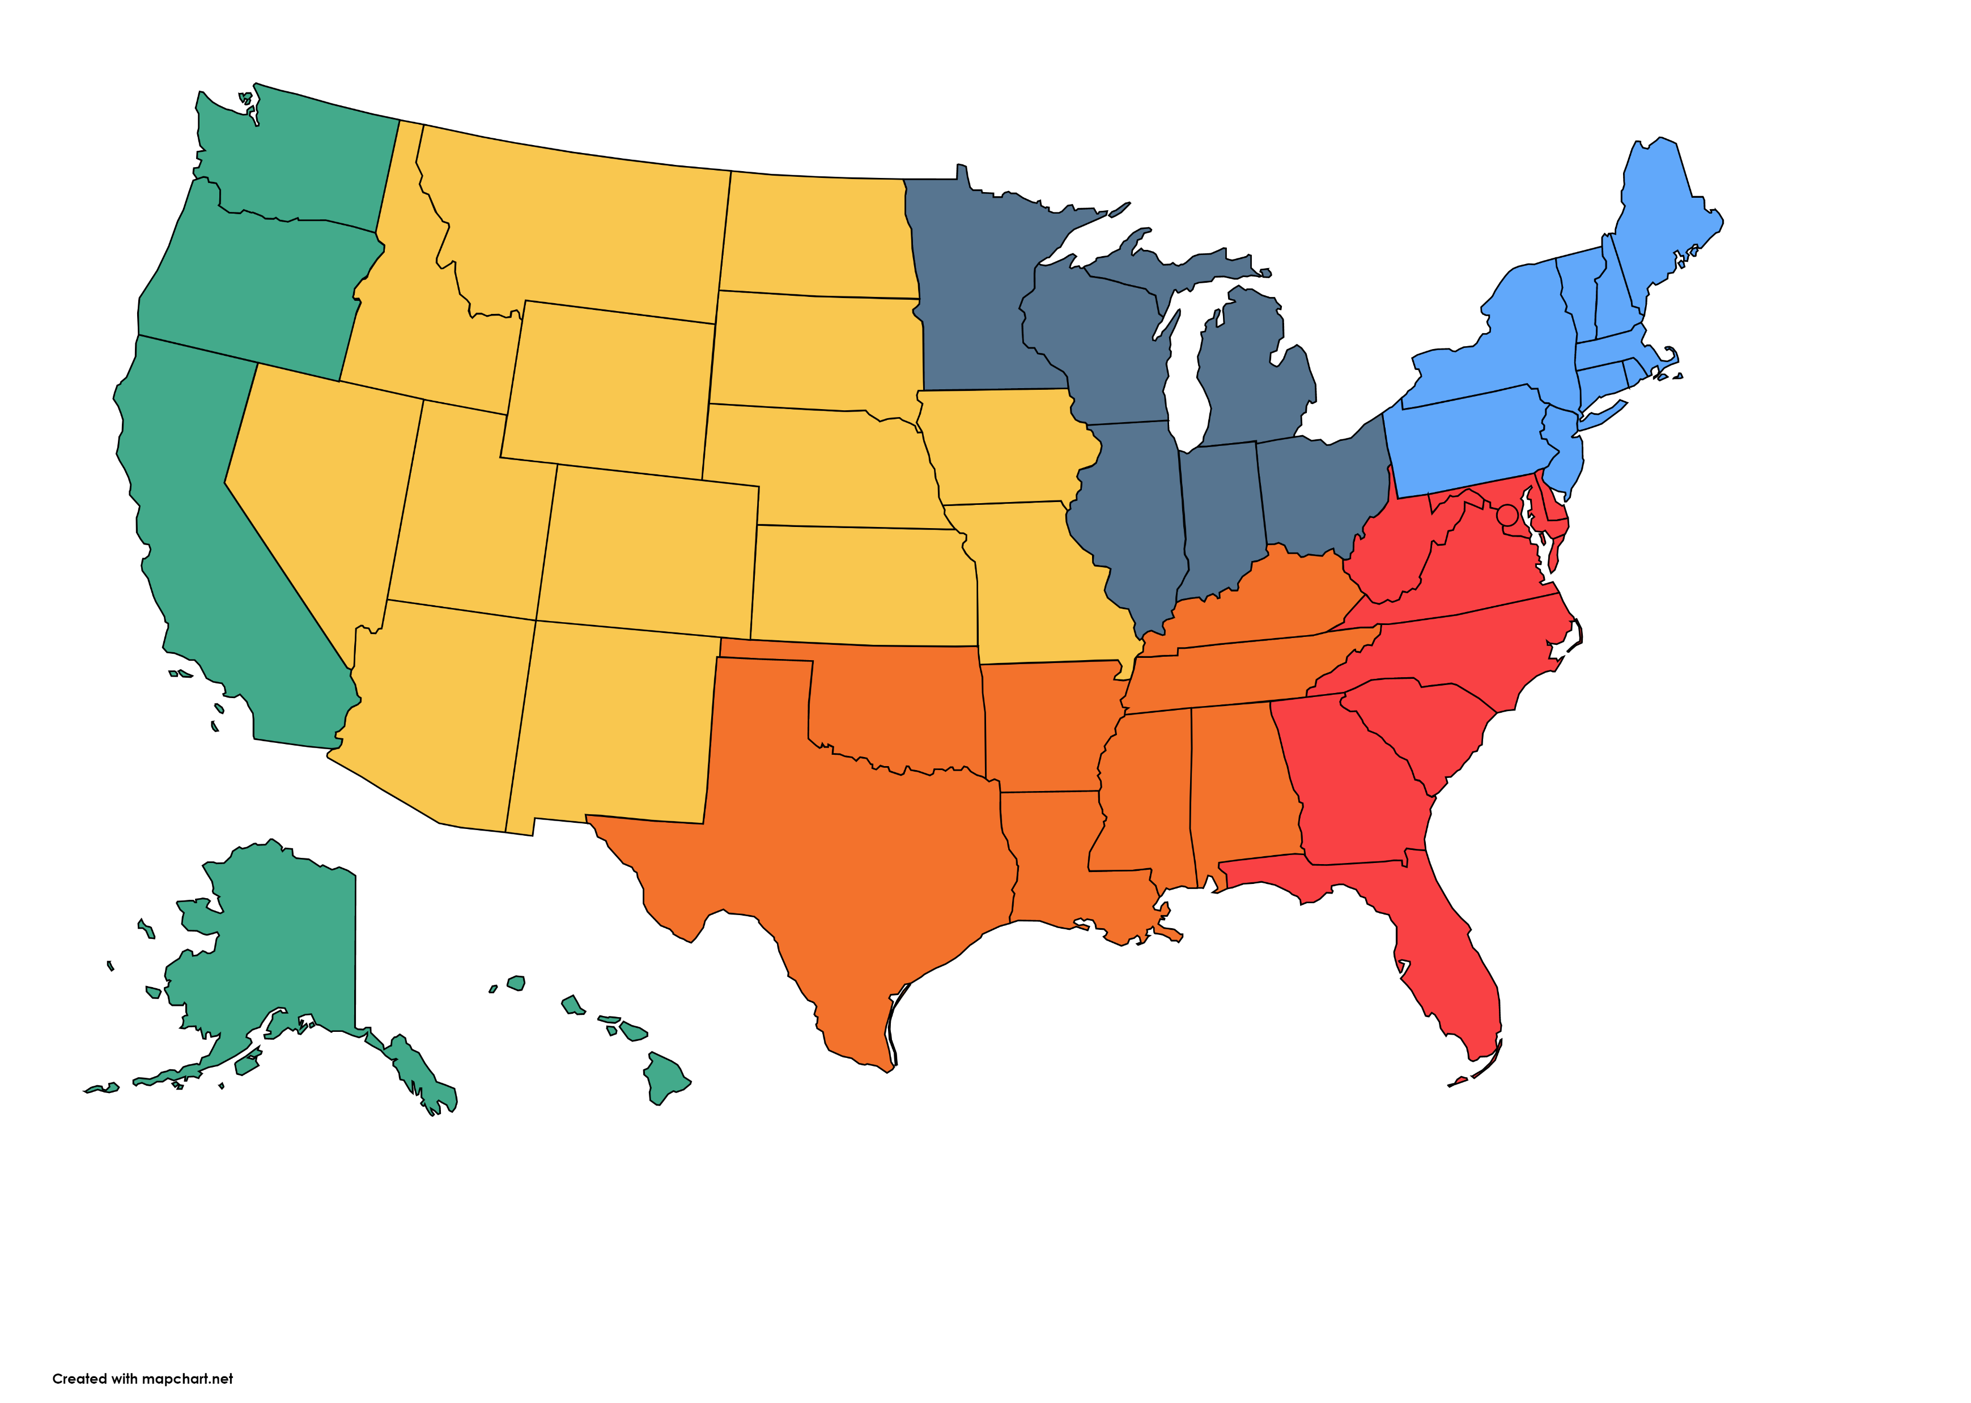
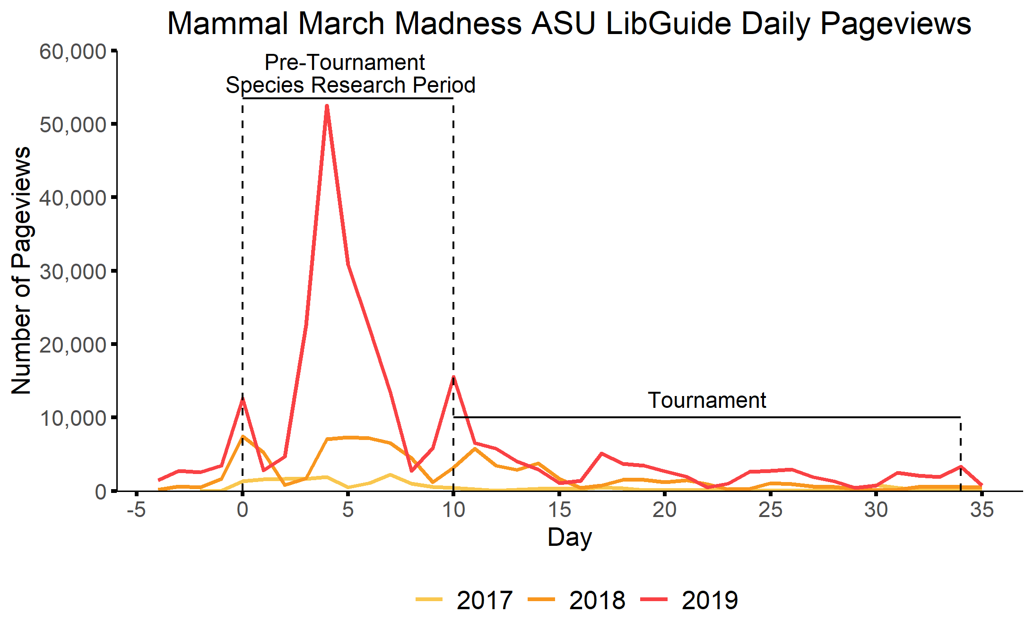
Bracket Drop

Slide 3


Slide 4
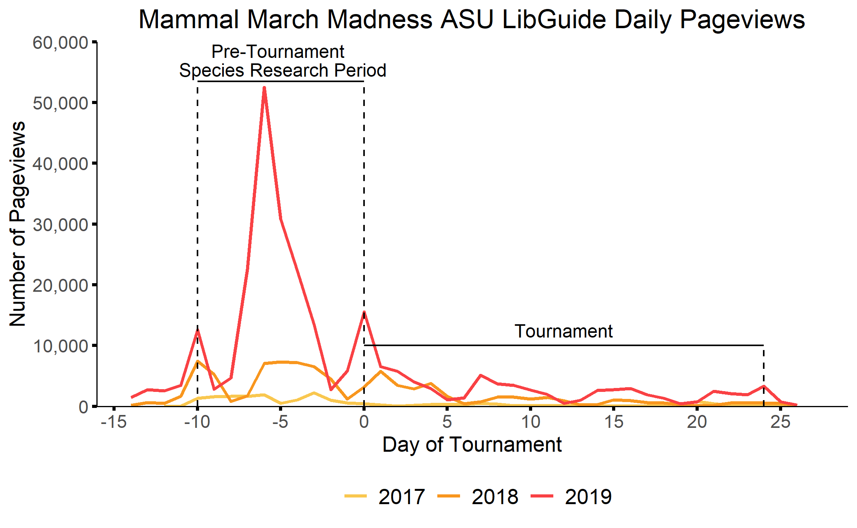
Bracket Drop
Bracket Drop

Slide 5
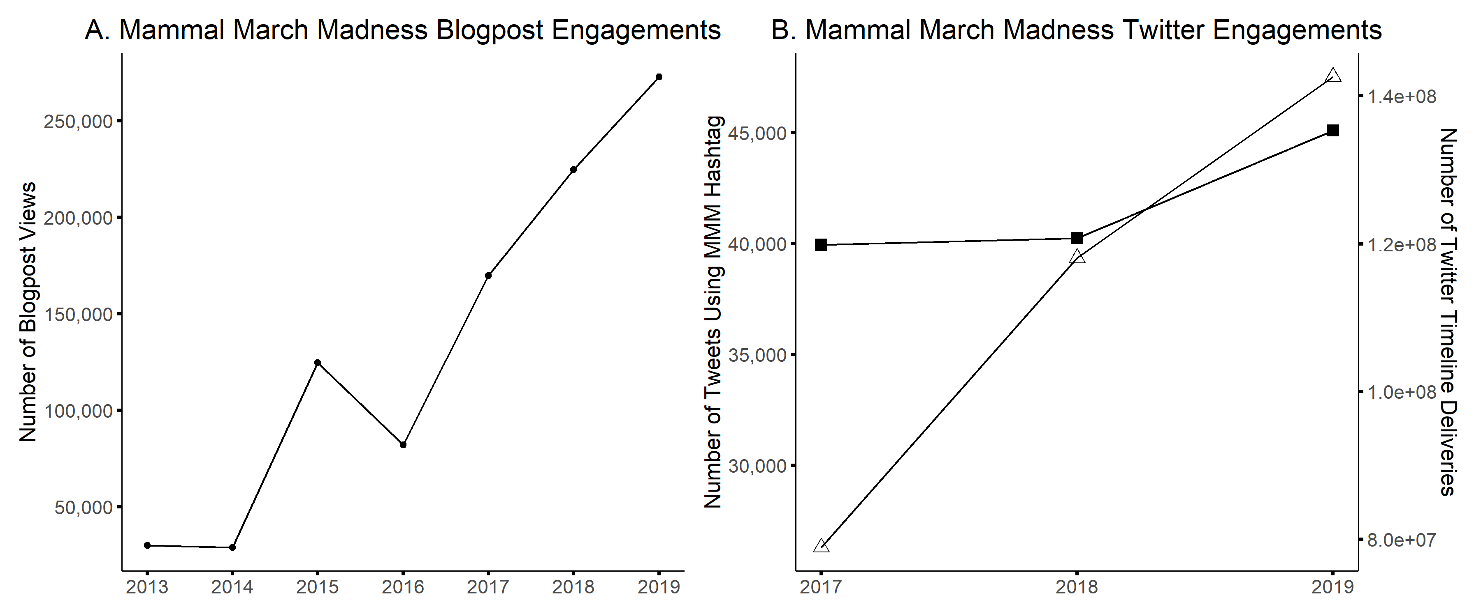
140,000,000
120,000,000
Number of Twitter Timeline Deliveries
100,000,000
Hashtag
Timeline Delivery
80,000,000

Slide 6
140,000,000
120,000,000
Number of Twitter Timeline Deliveries
100,000,000
Hashtag
Timeline Delivery
80,000,000

Slide 7
